Slide 1


MH2401:
Modelling Facebook
By: Humphrey George Chua
Toh Ker Yang
Toh Heng Wai
Toh Hong Kai
Ronnie Lai
Jeff Lim

Slide 2
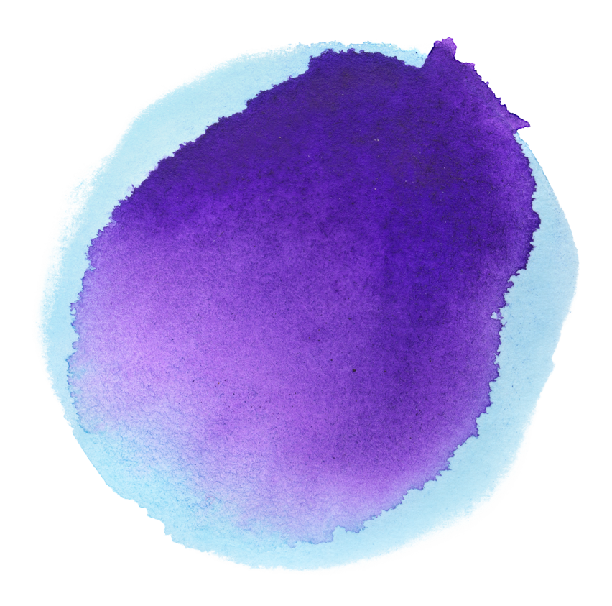
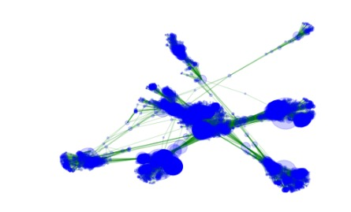
In order to model Facebook, we must first look at the characteristics of the Facebook model. We notice that:
Model is split into many clusters connected via a few edges between each cluster
Large clusters appear to be more connected to each other than smaller clusters.
Large clustering coefficient

Slide 3
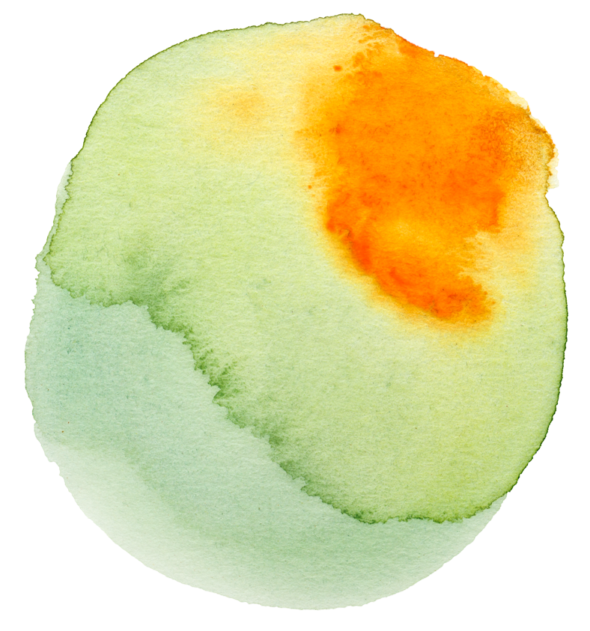
Custom Random Model
Step 1
Step 2
WS model used to form each cluster in order to obtain a high clustering coefficient. Clusters sorted to have the largest clusters in the middle and smallest at the end to create a distance between each cluster.
Clusters can be connected to each other by applying ER model concept to each combination of 2 clusters. The probability used for each pair of clusters is inversely proportional to the distance between them.
Variables
n
g
i
total number of nodes
number of clusters
a number between 0 and 1 for calculating k with respect to the number of nodes in each WS graph
p
q
probability of edges being rewired in each WS graph
probability of edges being formed between clusters at distance 1

Slide 4
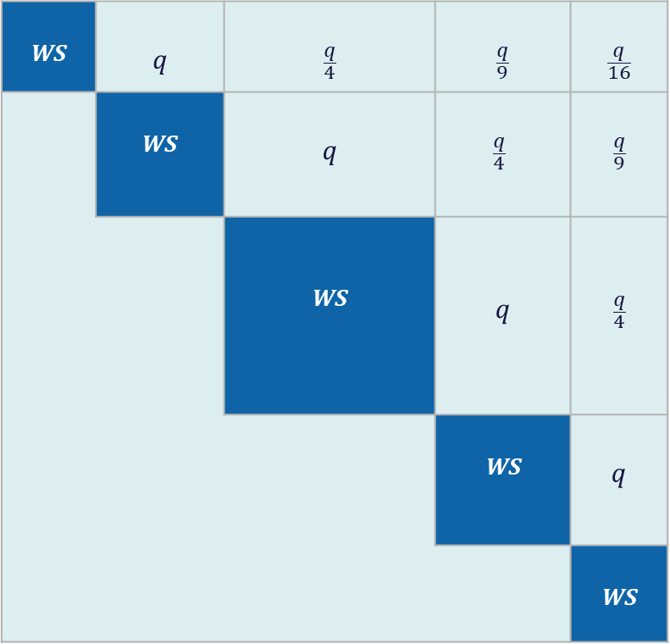
WS | q | $$\frac{q}{4}$$ | $$\frac{q}{9}$$ | $$\frac{q}{16}$$
 | WS | q | $$\frac{q}{4}$$ | $$\frac{q}{9}$$
 |  | WS | q | $$\frac{q}{4}$$
 |  |  | WS | q
 |  |  |  | WS

Slide 5
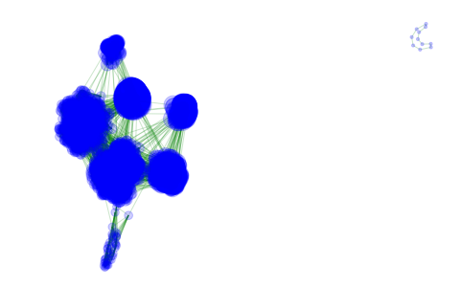

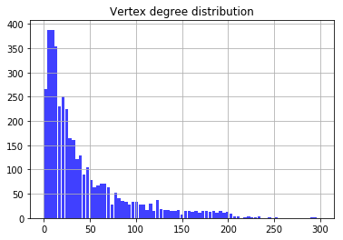
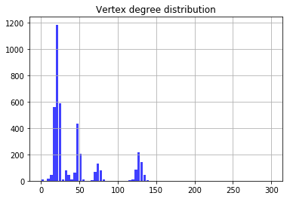
Facebook Network Graph
Custom Model Network Graph
Facebook Vertex Degree Distribution
Custom Model Vertex Degree Distribution

Slide 6

Model | |V| | |E| | CC | Average Path Length | Average Vertex Degree | Number of Triangles | Diameter
Facebook | 4039 | 88234 | 0.6055 | 3.6925 | 43.691 | 1612010 | 8
Custom | 4039 | 86495 | 0.5341 | - | 42.830 | 1190685 | -
ER | 4039 | 88574 | 0.0109 | 2.6034 | 43.859 | 14128 | 4
WS | 4039 | 88858 | 0.0655 | 3.2184 | 44 | 800625 | 5
BA | 4039 | 88374 | 0.0375 | 2.5123 | 43.760 | 86773 | 4
MDA | 4039 | 88605 | 0.0439 | 2.5098 | 43.874 | 105243 | 4

Slide 7
Task: Using PSO, find the most suitable p and q to minimize error.
Extract the “Trump-Kim Summit” data from google trend.
Conduct SIR modelling process on the Custom Network Model.
The aim is to reduce the total difference in the values between the modelled spread of information and the actual spread of information from the google trend graph. error term: ∑(truevalue − estimatedvalue)²
Run the PSO function to search for optimal value of p and q.

Slide 8
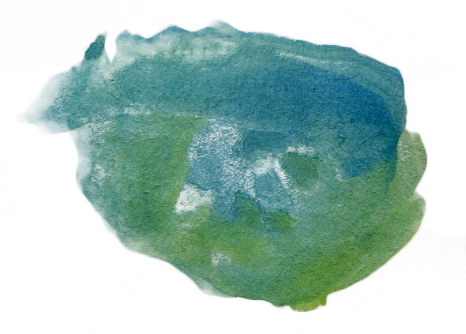
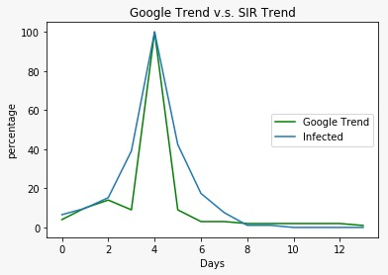
p = 0.285555 q = 0.645921 difference = 0.476836
DAY | 1 | 2 | 3 | 4 | 5 | 6 | 7 | 8 | 9 | 10 | 11 | 12 | 13 | 14
Google | 4 | 10 | 14 | 9 | 100 | 9 | 3 | 3 | 2 | 2 | 2 | 2 | 2 | 1
SIR | 6.52 | 9.78 | 15.21 | 39.13 | 100 | 42.39 | 17.39 | 7.61 | 1.09 | 1.09 | 0 | 0 | 0 | 0

Slide 9

Thank you!

